Slide 1
Marketing Analytics
Sameer Prajapati

Slide 2
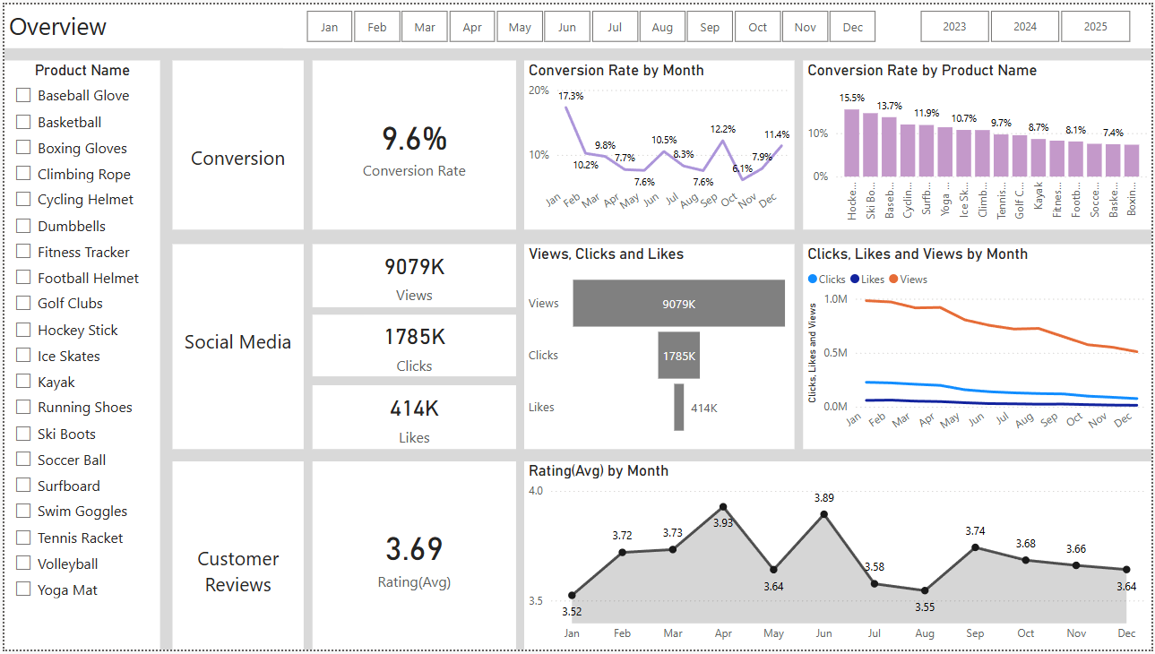
Overview
Key Observations:
Combines Conversion (9.6%), Social Media (9079K Views), and Customer Reviews (3.69).
Conversion by Product: Hockey Stick leads (15.5%); Boxing Gloves last (7.3%).
Engagement Drop:
Views: Constantly declining across months.
Clicks and Likes follow a similar trend.
Rating by Month: Peak in May (3.93), dips in July (3.55) and Sept (3.64).

Slide 3
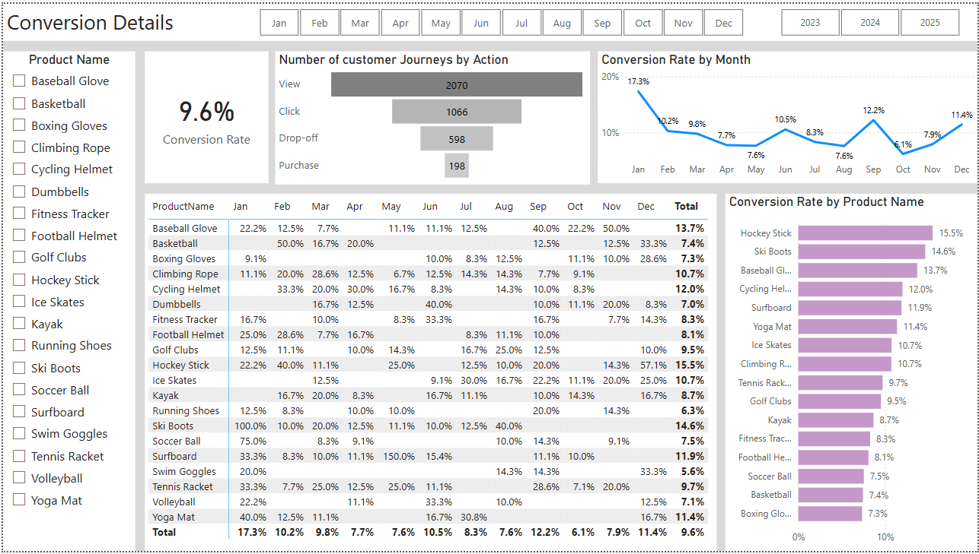
Conversion Rate
Problems:
Huge drop-off between Clicks and Purchases.
Several popular products (Basketball, Soccer Ball) have low conversion.
Inconsistent month-wise performance with long low-conversion periods (Apr to Oct).
Solutions:
Optimize checkout process to reduce drop-offs (simplify steps, better mobile UX).
Run remarketing campaigns for drop-offs.
Improve product pages for low-converting but high-engagement items (e.g., Basketball).
Create monthly campaigns to boost seasonal conversion (e.g., Ski Boots in winter).

Slide 4
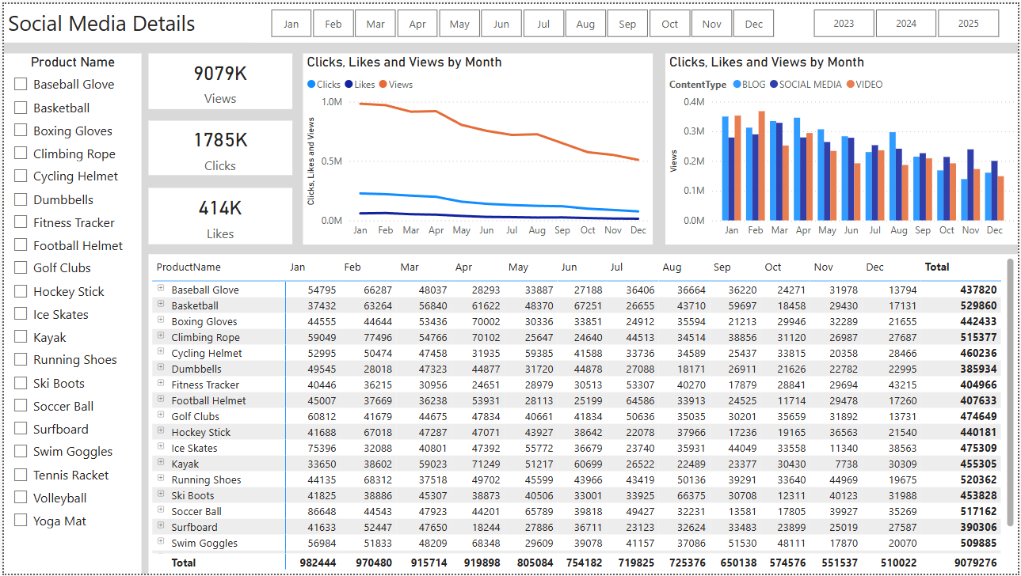
Social Media
Key Observations:
Total Views: 9M+, Clicks: 1.78M, Likes: 414K.
Views by Content Type: Videos lead, followed by Social Media and Blogs.
Engagement by Product:
Highest: Basketball (529K), Running Shoes (520K)
Lowest: Dumbbells, Football Helmet
Monthly Trend:
All metrics (views, clicks, likes) show a steady downward trend.
Problems:
High views but low conversions from social media.
Steady decline in performance over months.
Low-performing products still being promoted.
Solutions:
Invest in high-performing content types (short videos).
Use influencers or user-generated content for products like Running Shoes & Swim Goggles.
Pause promotion on underperformers and reallocate budget.

Slide 5
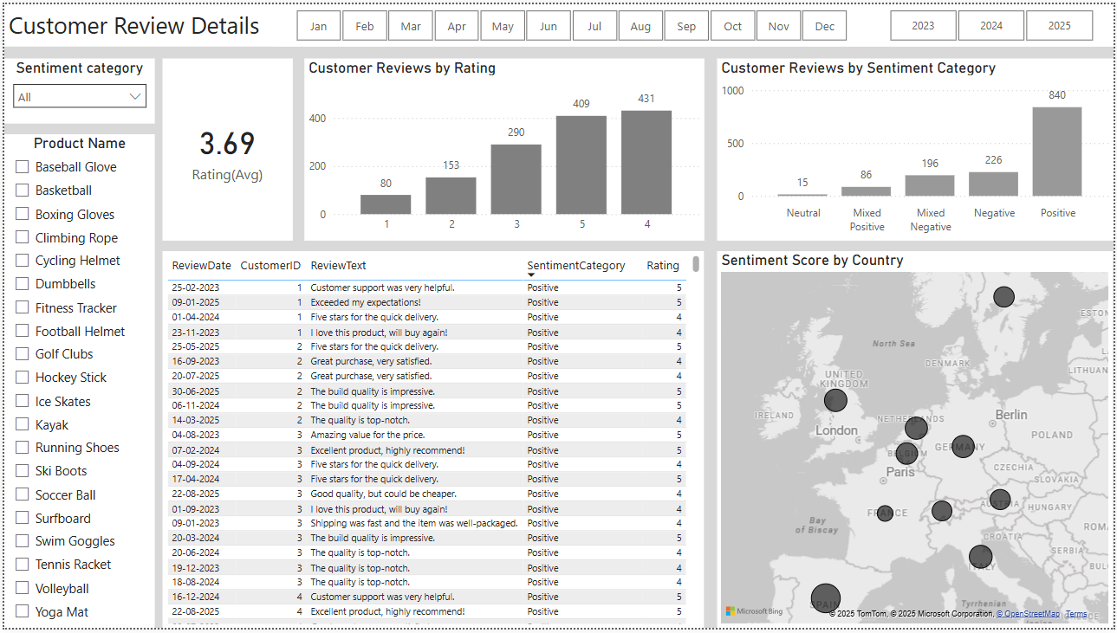
Customer Review
Problems:
Nearly 23% of feedback is negative or mixed.
Average rating below ideal 4.0 benchmark.
No product-wise rating split available here (missing granularity).
Solutions:
Respond to negative reviews to resolve issues and improve customer satisfaction.
Reward high-rating reviewers with loyalty points.
Use review text analysis to identify product flaws and improve quality.

Slide 6
Goals & Actions
Actions for Conversion Goals
Redesign product and checkout pages for clarity and speed.
Implement abandoned cart recovery (email/SMS reminders).
Use targeted retargeting ads for products with high drop-off.
Actions for Review Goals
Encourage reviews via post-purchase emails and loyalty rewards.
Regularly analyze feedback text to identify product improvement areas.
Promote top-rated reviews on product and landing pages.
Actions for Social Media Goals
Prioritize high-engagement content types like short-form videos.
Run influencer partnerships for trending or high-visibility products.
Use carousel posts and Reels on Instagram, Shorts on YouTube.
Increase overall conversion rate from 9.6% to 12%.
Improve conversion rates of low-performing products (e.g., Basketball, Soccer Ball).
Reduce drop-off rate between clicks and purchases.
Improve average customer rating from 3.69 to 4.2+.
Reduce percentage of negative and mixed reviews (currently 25%+).
Increase positive customer engagement and brand trust.
Increase social media click-through rate from views to clicks.
Reverse the monthly downward trend in views and likes.
Shift budget focus toward high-performing platforms and content types.

